Slide 1

Chapter 1: Introduction to Switched Networks
Routing And Switching
Notes:
Cisco Networking Academy program
Routing & Switching
Chapter 1: Introduction to Switched Networks

Slide 2
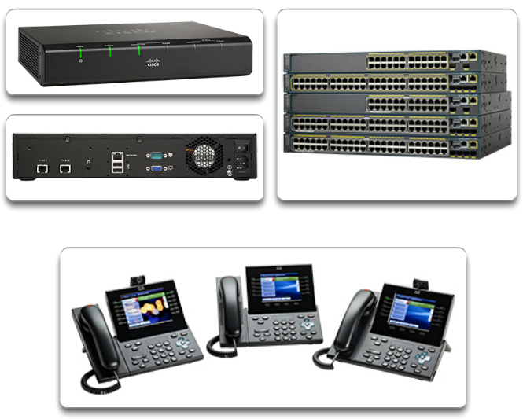
Converged Networks Growing Complexity of Networks
Our digital world is changing.
The ability to access the Internet and the corporate network is no longer confined to physical offices, geographical locations, or time zones. In today’s globalized workplace, employees can access resources from anywhere in the world and information must be available at any time, and on any device
Networks must be secure, reliable, and highly available.
These next generation networks must not only support current expectations and equipment, but must also be able to integrate legacy platforms.
Notes:
1.1 LAN Design
1.1.1 Converged Networks
1.1.1.1 Growing Complexity of Networks

Slide 3
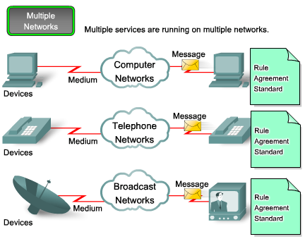
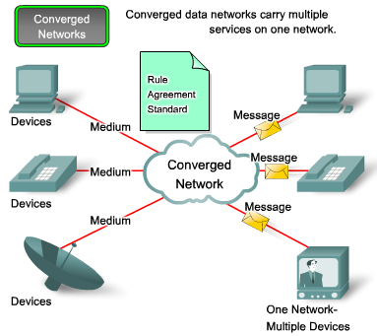
Converged Networks Elements Of A Converged Network
Collaboration is a requirement
To support collaboration, networks employ converged solutions
Data services such as voice systems, IP phones, voice gateways, video support, and video conferencing
Call control, voice messaging, mobility and automated attendant are also common features
Notes:
1.1 LAN Design
1.1.1 Converged Networks
1.1.1.2 Elements Of A Converged Network

Slide 4
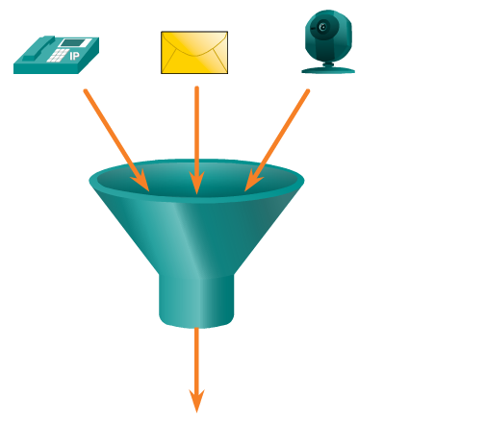
Converged Networks Elements Of A Converged Network
Technology advances are enabling us to consolidate these disparate networks onto one platform - a platform defined as a converged network.
Benefits of Converged Networks include:
Multiple types of traffic; Only one network to manage
Substantial savings over installation and management of separate voice, video and data networks
Integrates IT management
One of the primary benefits of transitioning to the converged network is that there is just one physical network to install and manage. This results in substantial savings over the installation and management of separate voice, video, and data networks.
Notes:
1.1 LAN Design
1.1.1 Converged Networks
1.1.1.2 Elements Of A Converged Network

Slide 5
Converged Networks Borderless Switched Networks
With the increasing demands of the converged network, the network must be developed with an architectural approach that embeds intelligence, simplifies operations, and is scalable to meet future demands.
Cisco Borderless Networks is the brand name for a set of hardware and software technologies which allow "anyone, anywhere, anytime, and on any device" to connect to an organization's network, securely, reliably, and seamlessly.
The product line was developed to meet the increased performance demands of streaming video, wireless networking, cloud and virtualization services, and the rising usage of smartphones and other consumer devices in the workplace.
It is designed to address IT and business challenges, such as supporting the converged network and changing work patterns.
Notes:
1.1 LAN Design
1.1.1 Converged Networks
1.1.1.3 Borderless Switched Networks

Slide 6
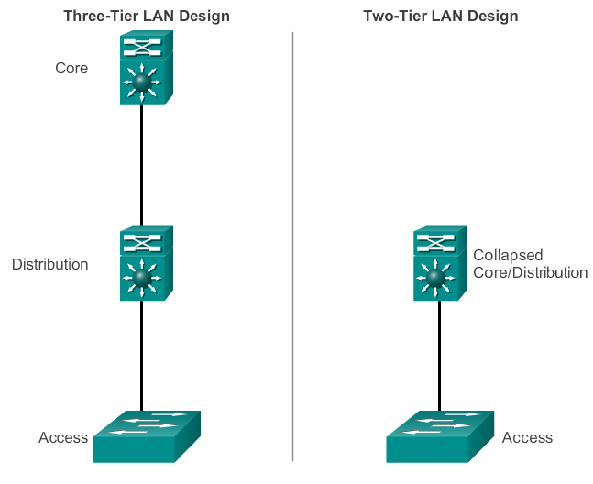
Converged Networks Hierarchy in the Borderless Switched Network
Creating a borderless switched network requires that sound network design principles are used to ensure maximum availability, flexibility, security, and manageability.
In smaller networks, it is not unusual to implement a collapsed core model, where the distribution layer and core layer are combined into one layer.
Notes:
1.1 LAN Design
1.1.1 Converged Networks
1.1.1.4 Hierarchy in the Borderless Switched Network

Slide 7
Converged Networks Borderless Switched Networks
Borderless switched network design guidelines are built upon the following principles:
Hierarchical - Facilitates understanding the role of each device at every tier, simplifies deployment, operation, and management, and reduces fault domains at every tier
Modularity - Allows seamless network expansion and integrated service enablement on an on-demand basis
Resiliency - Satisfies user expectations for keeping the network always on
Flexibility - Allows intelligent traffic load sharing by using all network resources

Slide 8
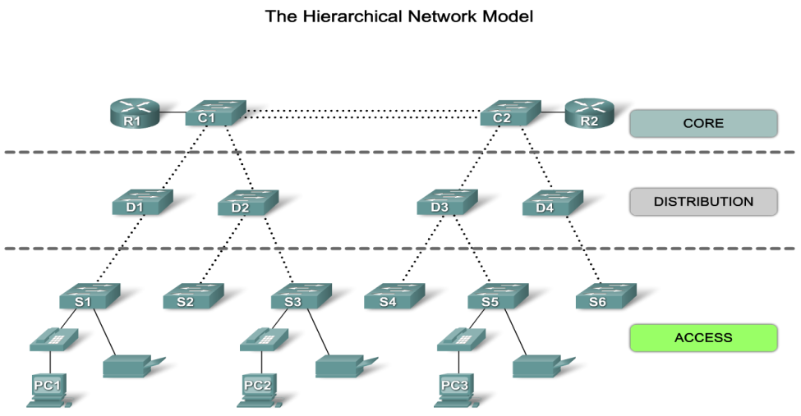
Hierarchical Network Model
When building a LAN that satisfies the needs of a small- or medium-sized business, your plan is more likely to be successful if a hierarchical design model is used.
Hierarchical network design involves dividing the network into discrete layers.
Each layer provides specific functions that define its role within the overall network.
By separating the various functions that exist on a network, the network design becomes modular, which facilitates scalability and performance.
The typical hierarchical design model is broken up in to three layers:
access
distribution
core
Notes:
Use graphic 1.1.1.1
Use graphic 1.1.1.3

Slide 9
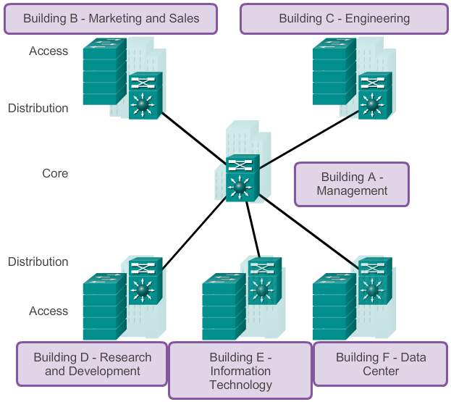
Converged Networks Core, Distribution, Access
Notes:
1.1 LAN Design
1.1.1 Converged Networks
1.1.1.5 Core, Distribution, Access

Slide 10
Hierarchical Network Model: 3 Layers
Access
Traditionally, the primary function of an access layer switch is to provide network access to the user. Access layer switches connect to distribution layer switches, which implement network foundation technologies such as routing, quality of service, and security..
Distribution
The distribution layer interfaces between the access layer and the core layer to provide many important functions, including:
Aggregating large-scale wiring closet networks
The distribution layer controls the flow of network traffic using policies and delineates broadcast domains by performing routing functions between virtual LANs (VLANs) defined at the access layer.
Distribution layer switches are typically high-performance devices that have high availability and redundancy to ensure reliability.
Providing intelligent switching, routing, and network access policy functions to access the rest of the network.
Core
The core layer of the hierarchical design is the high-speed backbone of the internetwork.
The core layer is critical for interconnectivity between distribution layer devices, so it is important for the core to be highly available and redundant.
The core area can also connect to Internet resources.
The core aggregates the traffic from all the distribution layer devices, so it must be capable of forwarding large amounts of data quickly.
Notes:
Use graphic 1.1.1.1
Use graphic 1.1.1.3

Slide 11
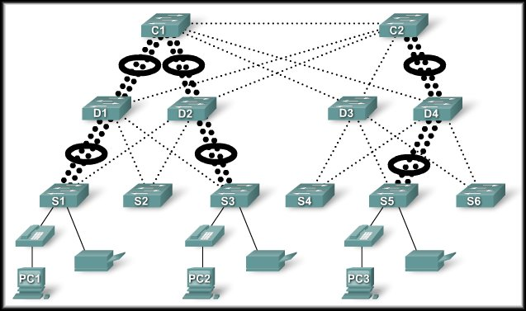
Principles of Hierarchical Network Design
Bandwidth Aggregation:
Link aggregation allows multiple switch port links to be combined so as to achieve higher throughput between switches.
The determining factor is using link aggregation is the requirements of the user applications.

Slide 12
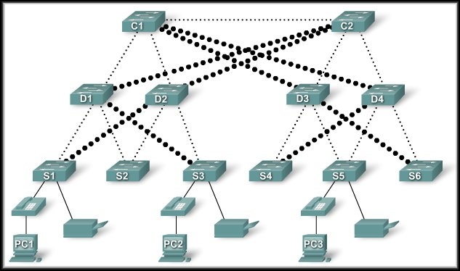
Principles of Hierarchical Network Design
Redundancy
:
Redundancy is one part of creating a highly available network.
Multiple links between switches or multiple devices.
It can get expensive and most likely will not be done on the access layer because of the cost and variety of devices.
It is feasible at the distribution and core layers.

Slide 13
Switched Networks Role of Switched Networks
The role of switched networks has evolved. It was not long ago that flat Layer 2 switched networks were the norm and relied on the widespread use of hub repeaters to propagate LAN traffic throughout an organization
A switched LAN allows more flexibility, traffic management and additional features, such as
Quality of service
Additional security
Support for wireless networking and connectivity
Support for new technologies, such as IP telephony and mobility services
Notes:
1.1 LAN Design
1.1.2 Switched Networks
1.1.2.1 Role of Switched Networks

Slide 14
Considerations when Selecting a Switch
Cost - The cost of a switch will depend on the number and speed of the interfaces, supported features, and expansion capability.
Port Density - Network switches must support the appropriate number of devices on the network.
Power - It is now common to power access points, IP phones, and even compact switches using Power over Ethernet (PoE). In addition to PoE considerations, some chassis-based switches support redundant power supplies.
Reliability - The switch should provide continuous access to the network
Port Speed - The speed of the network connection is of primary concern to end users.
Frame Buffers - The ability of the switch to store frames is important in a network where there may be congested ports to servers or other areas of the network.
Scalability - The number of users on a network typically grows over time; therefore, the switch should provide the opportunity for growth.

Slide 15
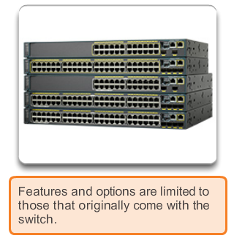
Switched Networks Form Factor
Fixed
Notes:
1.1 LAN Design
1.1.2 Switched Networks
1.1.2.2 Form Factor

Slide 16
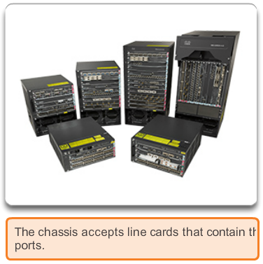
Switched Networks Form Factor
Modular
Notes:
1.1 LAN Design
1.1.2 Switched Networks
1.1.2.2 Form Factor

Slide 17
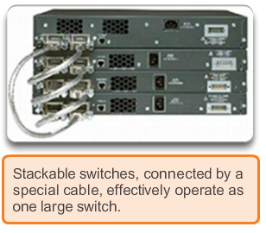
Switched Networks Form Factor
Stackable
Notes:
1.1 LAN Design
1.1.2 Switched Networks
1.1.2.2 Form Factor

Slide 18
Frame Forwarding Switching as a General Concept
A Switch makes a decision based on ingress (incoming) and destination port
A LAN switch keeps a table that it uses to determine how to forward traffic through the switch
Cisco LAN switches forward Ethernet frames based on the destination MAC address of the frames.
(See Animation 1.2.1.1)
Notes:
1.2 The Switched Environment
1.2.1 Frame Forwarding
1.2.1.1 Switching as a General Concept in Networking and Telecommunications

Slide 19
Frame Forwarding Dynamically Populating a Switch MAC Address Table
A switch must first learn which devices exist on each port before it can transmit a frame
It builds a table called a MAC address, or content addressable memory (CAM) table
The mapping device <-> port is stored in the CAM table
The information in the MAC address table I used to send frames
When a switch receives an incoming frame with a MAC address that is not found in the CAM table, it floods it to all ports but the one that received the frame.
Examines Source MAC to learn who is where.
Uses Destination MAC to switch frame to it target.
Notes:
1.2 The Switched Environment
1.2.1 Frame Forwarding
1.2.1.2 Dynamically Populating a Switch MAC Address Table

Slide 20
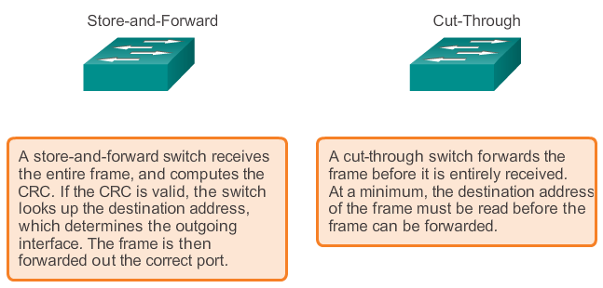
Frame Forwarding Modes of Operation Switch Forwarding Methods
Notes:
1.2 The Switched Environment
1.2.1 Frame Forwarding
1.2.1.3 Switch Forwarding Methods

Slide 21
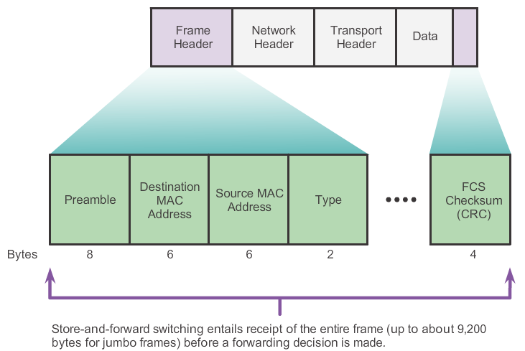
Frame Forwarding Store-and-Forward Switching
Reads in entire frame before forwarding.
Store-and-Forwarding allows the switch to:
Check for errors (via FCS check)
Perform Automatic Buffering
Slower forwarding
The port buffering process used by store-and-forward switches provides the flexibility to support any mix of Ethernet speeds.
Notes:
1.2 The Switched Environment
1.2.1 Frame Forwarding
1.2.1.4 Store-and-Forward Switching

Slide 22
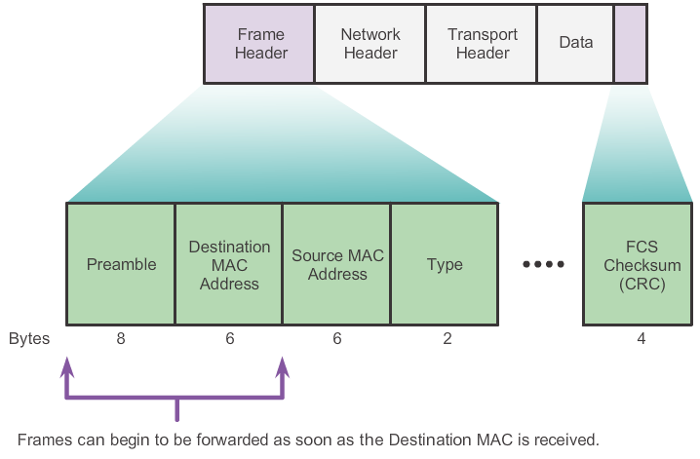
Frame Forwarding Cut-Through Switching
Cut-Through allows the switch to start forwarding in about 10 microseconds.
As soon as it reads the dest’ MAC it starts forwarding.
No FCS check
No Automatic Buffering
Notes:
1.2 The Switched Environment
1.2.1 Frame Forwarding
1.2.1.5 Cut-Through Switching

Slide 23
Frame Forwarding Cut-Through Switching
There are two variants of cut-through switching:
Fast-forward switching: offers the lowest level of latency.
Fast-forward switching is the typical cut-through method of switching, immediately forwards a packet after reading the destination address.
Because fast-forward switching starts forwarding before the entire packet has been received, there may be times when packets are relayed with errors.
Fragment-free switching: In fragment-free switching, the switch stores the first 64 bytes of the frame before forwarding.
Is the compromise between store-and-forward switching and cut-through switching. The reason fragment-free switching stores only the first 64 bytes of the frame is that most network errors and collisions occur during the first 64 bytes.
Fragment-free switching tries to enhance cut-through switching by performing a small error check on the first 64 bytes of the frame to ensure that a collision has not occurred before forwarding the frame.
Notes:
Use graphic 1.1.1.1
Use graphic 1.1.1.3

Slide 24
Switching Domains Collision Domains
Collision domain is the segment where devices must compete to communicate
All ports of a hub belong to the same collision domain
Every port of a switch is a collision domain on its own
A switch break the segment into smaller collision domains, easing device competition. (eliminates collisions)
Notes:
1.2 The Switched Environment
1.2.2 Switching Domains
1.2.2.1 Collision Domains

Slide 25
Switching Domains Broadcast Domains
Broadcast domain is the extend of the network where a broadcast frame can be heard.
Switches forward broadcast frames to all ports. Therefore switches don’t break broadcast domains.
All ports of a switch (with its default configuration) belong to the same broadcast domain
If two or more switches are connected, broadcasts will be forward to all ports of all switches (except for the port that originally received the broadcast)
Notes:
1.2 The Switched Environment
1.2.2 Switching Domains
1.2.2.2 Broadcast Domains

Slide 26
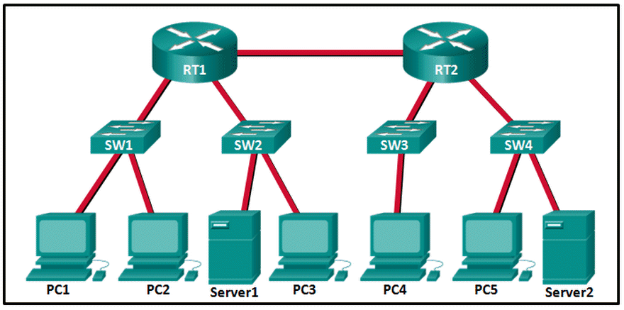
Collision/Broadcast Domains
How many Collision Domains?
How many Broadcast Domains?
12
5

Slide 27
Switching Domains Alleviating Network Congestion
Switches help alleviating network congestion by:
facilitating the segmentation of a LAN into separate collision domains
providing full-duplex communication between devices
taking advantage of their high port density
buffering large frames
employing high speed ports
taking advantage of their fast internal switching process
having a low per-port cost
Notes:
1.2 The Switched Environment
1.2.2 Switching Domains
1.2.2.4 Alleviating Network Congestion

Slide 28


